Slide 1
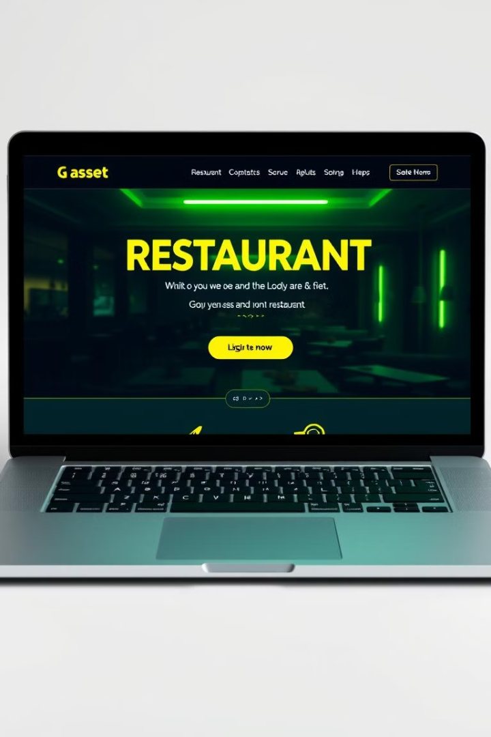
My Restaurant Website
Welcome to the presentation showcasing my newly developed restaurant website! This website is built to enhance the online presence of any restaurant, attracting more customers and streamlining their operations.

Slide 2
Introduction
The purpose of this website is to provide a comprehensive online platform for a restaurant.
It aims to attract new customers and foster a loyal customer base.
It also aims to improve restaurant efficiency and customer satisfaction.

Slide 3

Technology Stack
HTML
CSS
The foundation of the website, providing the structure and content.
Styles the website, ensuring an aesthetically pleasing and user-friendly look.
Tailwind CSS
Bootstrap
A utility-first CSS framework, accelerating development with pre-defined styling classes.
Provides a responsive framework, ensuring the website adapts to various screen sizes.

Slide 4
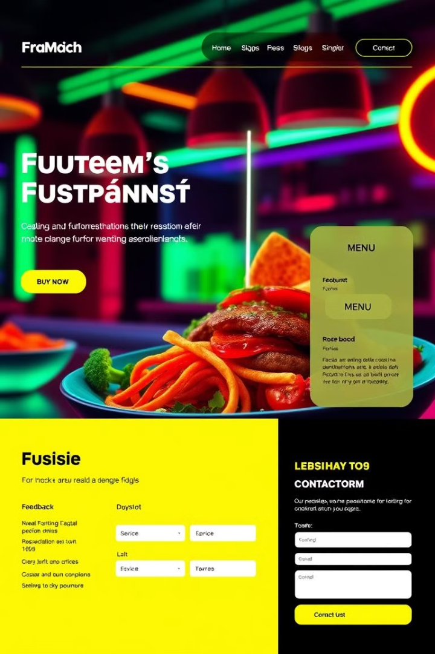
Key Features
Home Page
Feedback Form
Provides a welcoming introduction to the restaurant with a clear call to action.
Allows customers to provide feedback and suggestions, helping the restaurant improve.
Contact Us
Menu
Offers customers various ways to contact the restaurant with any queries or reservations.
Displays the restaurant's menu with detailed descriptions and pricing.

Slide 5




Advantages
Increased Reach
Enhanced Customer Experience
Improved Efficiency
The website expands the restaurant's reach to a wider audience, attracting more potential customers.
The website automates processes like online orders and reservations, simplifying operations.
The website provides a seamless and user-friendly experience, improving customer satisfaction.

Slide 6
Challenges and Solutions
Design Complexity
1
The website required a balance between appealing aesthetics and user-friendly navigation.
Responsive Design
2
The website needed to adapt flawlessly across various devices, ensuring optimal viewing on desktops, tablets, and mobile phones.
Content Management
3
The website required a system for updating menu items, special offers, and other relevant information.

Slide 7

Improved User Experience
1
User-Friendly Interface
A simple and intuitive interface for easy browsing and navigation.
2
Interactive Elements
Interactive elements like the feedback form and contact us section engage customers.
3
Fast Loading Times
Optimized website performance ensures fast loading times, enhancing user satisfaction.

Slide 8




Scalability and Maintainability
Modular code structure for easy modification and future expansion.
Well-documented codebase for seamless updates and maintenance.
Implementation of a content management system for easy updates to menu items, pricing, and other content.

